Slide 1





SPY AGENCY 2024
PROJECT REPORT
OBJECT-ORIENTED PROGRAMMING (OOP) COURSE
ACADEMIC YEAR 2024-2025
Student:
Duong Tri Nhan – 97482403193
Class: 24CNTT
Instructor:
Dr. Le Ngoc Hieu

Slide 2


TABLE OF CONTENT
1.
INTRODUCTION
3.
CONCLUSION
2.
CONTENT

Slide 3

LIST OF ABBREVIATIONS
ABBREVIATION | EXPLANATION
DAO | Data Access Object
CRUD | Create, Read, Update, Delete
DB | Date Base
OOP | Object-Oriented Programming
UI | User Interface
MVC | Model – View – Controller
PK | Primary Key
JDBC | Java DataBase Connectivity

Slide 4


Reason for Topic Selection
INTRODUCTION

Slide 5
INTRODUCTION
Reason for Topic Selection
- In the context of rapid technological development, the use of software for data management and analysis has become an inevitable trend, especially in fields requiring high security and fast processing speeds such as intelligence.
- Currently, there is still a lack of applications for managing agent data that are both simple to use and fully functional. Based on this reality, our team has chosen to develop the project “SpyAgency2024” – a desktop software designed to manage information about agents, missions, skills, and relationships within the organization.
- The software: + Features a user-friendly, intuitive interface that supports data lookup, statistical analysis and data visualization through charts using the JFreeChart library. + Uses Java Swing to build the interface, MySQL for data storage, and applies object-oriented programming (OOP) to design a clear, layered program structure.
- Throughout the project, our team has strengthened skills in Java programming, data handling, and data visualization.
- We believe the product meets the course requirements and has strong potential for practical application.

Slide 6
INTRODUCTION
Research Purpose
- The project “SpyAgency2024” aims to develop a desktop application using Java Swing to manage, store, and analyze intelligence data in a scientific and efficient manner. The software supports the management of information related to agents, missions, skills, and organizations, while also integrating features for data statistics and visualization through charts.
- Through this project, our team aims to apply knowledge of OOP, Java Swing, and MySQL database management in practice, while improving programming skills, teamwork, and the ability to implement a complete software project.

Slide 7
INTRODUCTION
Research Objectives
- Design and build a database system to store information about spies, missions, skills, organizations and relationships in a logical, coherent and scalable manner.- Develop a user-friendly desktop graphical interface using Java Swing that is intuitive, easy to use, and fully supports all necessary data management functions.
- Developing user-friendly desktop graphical interface using Java Swing, ensuring ease of use, intuitiveness, and full support of necessary functions for data management.
- Build a user authorization system with secure login using SHA-256 hashed passwords.
- Full implementation of data management functions (CRUD: Add – Edit – Delete – Search) for agent information tables, tasks, skills, organizations, groups, and associated tables.
- Integrate data statistics and visualization features using the JFreeChart library.
- Adhere to the principles of object-oriented programming (OOP) and apply a reasonable software layering model: Model – DAO – Controller – Chart – ChartDAO – View – Config – Icon. to ensure the system is easy to maintain, easy to extend and reuse.

Slide 8
INTRODUCTION
General Description of the Developed System
- The Spy Agency Management system is built as a desktop application using the Java programming language, with a GUI designed in Java Swing and a database stored on MySQL. Allows for efficient and intuitive management of spy data, tasks, groups, skills, foreign languages, affiliated units and security levels.
- The functions of visualizing analytical data through statistical charts using the JFreeChart library help the leadership quickly grasp the situation of task assignment, number of spies, safety level, personnel allocation in intelligence campaigns, minimize errors, avoid fraud, and improve management efficiency.

Slide 9
CONTENT

Slide 10

CHAPTER 1
CHAPTER 1
Theoretical Basis and Current Research Status

Slide 11
CHAPTER 1
CHAPTER 1
Theoretical Basis and Current Research Status
1.1. Scientific Basis: 1.1.1. Overview of Object-Oriented Programming:
- Object-Oriented Programming (OOP) is a programming paradigm based on the concept of "objects," where these objects contain data (called attributes) and actions that manipulate the data (called methods). OOP offers a visual, structured, and manageable approach, especially suitable for systems with complex data and multiple interacting objects.
- During the development of the SpyAgency2024 project, the team fully applied the fundamental principles of object-oriented programming to design and organize the source code logically, ensuring scalability and maintainability

Slide 12
CHAPTER 1
CHAPTER 1
Theoretical Basis and Current Research Status
1.1. Scientific Basis: 1.1.1. Overview of Object-Oriented Programming:
Specifically:
+ Polymorphism: Enables different objects to use a common interface but implement it in their own way. This feature is demonstrated through method overriding and method overloading mechanisms.
+ Abstraction: Allows developers to focus on core components while hiding complex implementation details. Abstract classes or interfaces define required behaviors, with subclasses providing the implementation. This simplifies the system and increases flexibility and scalability in software development.
+ Encapsulation: Ensures that important object data is protected from unwanted external influences. Model classes such as Agent, Mission, Skill, Team, etc., declare their attributes as private and provide public getter/setter methods to safely access the data.
+ Inheritance: Allows child classes to inherit common attributes and methods from parent classes, reducing code duplication and establishing a clear hierarchical relationship between objects. For example, the project may build a BaseDAO class containing basic database operation methods, which AgentDAO, MissionDAO, and other DAO classes inherit for reuse and extension.

Slide 13
CHAPTER 1
CHAPTER 1
Theoretical Basis and Current Research Status
1.1. Scientific Basis: 1.1.1. Overview of Object-Oriented Programming:
- Applying these fundamental OOP principles in the SpyAgency2024 project not only helps organize the source code clearly, making it easy to read and maintain, but also creates a solid foundation for the team to develop new features in the future without affecting the existing system structure.

Slide 14
CHAPTER 1
CHAPTER 1
Theoretical Basis and Current Research Status
1.1. Scientific Basis: 1.1.2. Java Swing Technology in Desktop Application Development:
- Java Swing is a powerful user interface library within the Java Standard Edition, widely used to develop desktop applications. Swing provides a diverse set of GUI components such as buttons, labels, text boxes, tables, panels, etc., along with customizable interfaces and flexible event handling capabilities, enabling developers to build software with user-friendly and easy-to-use interfaces.
- In the SpyAgency2024 project, Java Swing plays a key role as the main technology for designing and developing the user interface of the agent management software.

Slide 15
CHAPTER 1
CHAPTER 1
Theoretical Basis and Current Research Status
1.1. Scientific Basis: 1.1.2. Java Swing Technology in Desktop Application Development:
The prominent features applied during development include:
+ Event handling: The application leverages Swing’s event handling mechanism to respond to user actions such as button clicks, table selections, data searches, and chart creation... + UI customization: Java Swing allows changing colors, fonts, borders, icons, etc. to create a consistent, user-friendly, and visually intuitive interface.
+ Integration with data visualization libraries: Although Swing lacks a visual builder like JavaFX’s SceneBuilder, it is fully compatible with libraries such as JFreeChart, facilitating easy embedding of charts into the application.
+ Rich set of UI components: Swing offers comprehensive components like JButton, JLabel, JTextField, JComboBox, JTable, JScrollPane, etc., which help the team design data input forms, display data tables, and control panels flexibly and efficiently.
+ Layout management: Swing supports arranging UI components using various layout managers such as BorderLayout, FlowLayout, and GridLayout, helping create clear and neat working windows.

Slide 16
Z
CHAPTER 1
CHAPTER 1
Theoretical Basis and Current Research Status
1.1. Scientific basis: 1.1.3. MySQL Database Management System and SQL Language:
- In the SpyAgency2024 project, the system uses MySQL as the primary database management system, deployed via XAMPP — a popular server emulator integrating Apache, MySQL, PHP and phpMyAdmin to simplify database installation and management on personal computers.
+ Data querying with SQL: The system uses SQL to perform database operations like inserting (INSERT), updating (UPDATE), deleting (DELETE), searching (SELECT), and aggregating data from tables.
+ Database management via phpMyAdmin (XAMPP): Alongside MySQL Workbench, the team uses phpMyAdmin integrated in XAMPP to create tables, edit data, and quickly test SQL queries during development.
+ Table-based data management: The system organizes and stores in tables, each consisting of rows (records) and columns (fields). Tables are linked via primary keys and foreign keys to ensure data integrity and logical relationships between entities such as agents, missions, skills, and organizations.

Slide 17
Z
CHAPTER 1
CHAPTER 1
Theoretical Basis and Current Research Status
1.1. Scientific basis: 1.1.3. MySQL Database Management System and SQL Language:
+ Java connectivity through JDBC: To enable Java Swing software to communicate with the database, the team uses JDBC (Java Database Connectivity) — a standard Java API for connecting and executing SQL commands. The connection class is organized separately for better management and reuse across the project.
- Using XAMPP offers many benefits such as easy installation, convenient local database management, and suitability for internal desktop projects like SpyAgency2024.

Slide 18
Z
CHAPTER 1
CHAPTER 1
Theoretical Basis and Current Research Status
1.1. Scientific basis: 1.1.4. Data Structures and Java Collections Framework:
- During the development of the SpyAgency2024 application, choosing appropriate data structures played an important role in optimizing performance and simplifying data handling. The project utilized JFreeChart — an open-source Java library supporting the creation of professional 2D charts. In the SpyAgency2024 project, the team used JFreeChart to visualize intelligence data and statistical results.
- Types of charts used:
+ Bar Chart: Displays the top agents with the highest number of missions.
+ Pie Chart: Shows the distribution of agents by nationality.
+ Line Chart: Tracks the number of missions over the years.
- Dataset: The data for charts is organized in the form of DefaultCategoryDataset for bar and line charts, and DefaultPieDataset for pie charts, helping to visualize information effectively

Slide 19
Z
CHAPTER 1
CHAPTER 1
Theoretical Basis and Current Research Status
1.1. Scientific basis: 1.1.4. Data Structures and Java Collections Framework:
- Chart customization: JFreeChart supports customizing titles, axis labels, colors, fonts, and sizes, enabling the creation of visually appealing and clear charts
- Integration with Java Swing: Charts are embedded directly into Swing via ChartPanel, allowing charts to be displayed alongside data tables and management forms within the same working window.
- Principles of effective visualization: The team focuses on selecting chart types appropriate for each data set, using distinguishable colors and logical layouts to help users easily grasp information without confusion.

Slide 20
Z
CHAPTER 1
CHAPTER 1
Theoretical Basis and Current Research Status
1.2. Current Research Status: 1.2.1. Modern Technology Status:
In today’s era of rapid digital transformation, information technology has been continuously advancing, providing numerous powerful tools and platforms to support data collection, management, analysis, and visualization across many fields, especially in security and intelligence.
Notable technologies and platforms include:

Slide 21
Z
CHAPTER 1
Theoretical Basis and Current Research Status
CHAPTER 1
1.2. Current Research Status: 1.2.1. Modern Technology Status:
Notable technologies and platforms include:
Desktop application development platforms:
Java, especially with the Java Swing library, remains a popular and stable tool for building desktop applications due to its strong data processing capabilities, user-friendly interfaces, and ease of integration with external libraries. Other platforms like .NET (C#) and Python (Tkinter, PyQt) are also widely used in developing data management software.
Database management systems:
MySQL, PostgreSQL, and SQL Server continue to be popular choices for data storage. Additionally, NoSQL databases such as MongoDB are gradually being adopted for systems requiring flexible and unstructured data processing.
Data visualization libraries: Besides JFreeChart for Java, libraries like Matplotlib, Seaborn (Python), D3.js (JavaScript), and advanced data analytics/BI platforms like Power BI and Tableau are widely used for data visualization and analysis. However, most of these tools serve general analysis purposes and are less often implemented in specialized intelligence applications.
Development and project management tools: Modern IDEs such as NetBeans, IntelliJ IDEA, and Eclipse provide excellent support for Java Swing development. Database management tools like phpMyAdmin (within XAMPP) and MySQL Workbench help design and test databases visually. Source code management with Git and project building with Maven have become popular standards.

Slide 22
Z
CHAPTER 1
CHAPTER 1
Theoretical Basis and Current Research Status
1.2. Current Research Status: 1.2.1. Modern Technology Status:
Assessment: With the rapid advancement of modern technologies, developing specialized intelligence data management and analysis software like SpyAgency2024 is entirely feasible. The challenge lies in selecting the right technologies and integrating components optimally to fully meet business requirements and ensure easy future expansion.

Slide 23
Z
CHAPTER 1
CHAPTER 1
Theoretical Basis and Current Research Status
1.2. Current Research Status: 1.2.2. Analysis od Similar Management and Data Analysis Applicarions and Solutions
Currently, several systems and applications have been developed to support the management and analysis of intelligence data or similar organizational personnel data.
However, certain limitations still exist:

Slide 24
Z
CHAPTER 1
CHAPTER 1
Theoretical Basis and Current Research Status
1.2. Current Research Status: 1.2.2. Analysis od Similar Management and Data Analysis Applicarions and Solutions
However, certain limitations still exist:
General personnel or organizational management software: There are many software solutions that support personnel and organizational management. However, these applications usually only serve the needs of managing personal information and tasks without the capability for in-depth statistical analysis or data visualization specifically for the intelligence field.
Mobile or web-based applications: Some mobile or web applications assist in storing and updating personnel information, but few focus on mission data statistics or the relationships between individuals in intelligence organizations. Moreover, they often lack data visualization features to support analytical processes.
Business Intelligence (BI) tools: Software such as Power BI, Tableau, or Google Data Studio can connect to and analyze data from multiple sources. However, they require users to have BI knowledge and technical skills to configure connections and design dashboards. Additionally, these are general-purpose analytical tools, not specifically packaged or tailored for intelligence agencies or internal security departments.
Open-source projects: Some programming communities or research groups have developed personnel management or intelligence data projects on a small scale. However, these projects are often experimental or academic in nature, lacking optimized user interfaces and missing direct data visualization features within desktop software.

Slide 25
Z
CHAPTER 1
CHAPTER 1
Theoretical Basis and Current Research Status
1.2. Current Research Status: 1.2.2. Analysis od Similar Management and Data Analysis Applicarions and Solutions
Summary: From the above status, it is clear that there are few complete and user-friendly solutions specifically for intelligence data management and analysis. Therefore, the SpyAgency2024 project aims to build a simple, easy-to-use desktop application that integrates comprehensive features for managing agents and missions, with built-in data visualization through charts within the software itself, while ensuring extensibility and internal data security.

Slide 26
CHAPTER 2
CHAPTER 2
Proposed Solution and Application Design Analysis

Slide 27
CHAPTER 2
CHAPTER 2
Proposed Solution and Application Design Analysis
2.1. Proposed Solution
- The application "SpyAgency2024" is proposed as a desktop software built using the Java programming language with the Java Swing library for designing the graphical user interface (GUI). Data related to agents, missions, skills, teams, and their relationships will be stored and managed in a MySQL database. The database is deployed via XAMPP and managed using the phpMyAdmin tool.
- Data statistics and intelligence visualization functions will be implemented using the JFreeChart library, integrated directly into the Swing application through ChartPanel to optimize the build process.

Slide 28
CHAPTER 2
CHAPTER 2
Proposed Solution and Application Design Analysis
2.1. Proposed Solution
2.1.1. General Architecture
- The application is designed with a multi-layered architecture following the Model–View–Controller (MVC) pattern to ensure modularity, maintainability, and extensibility:
+ View Layer (Java Swing): Responsible for displaying information and receiving user interactions via graphical interfaces designed with Java Swing components such as JButton, JTextField, JTable, JComboBox, JLabel, etc. Charts are embedded directly into the interface windows using ChartPanel from the JFreeChart library.
+ Controller Layer: Acts as the bridge between the view and data processing layers. Controllers handle user-generated events, invoke methods from DAO or Chart classes to retrieve data, process results, and update the corresponding views.
+ Model Layer: Represents the data entities in the application such as Agent, Mission, Skill, Team, etc. These classes use private attributes and provide public getter/setter methods to ensure encapsulation and data protection.
+ Data Access Object Layer (DAO): Handles direct database operations through JDBC. DAO classes provide CRUD methods (Create, Read, Update, Delete), as well as basic search and statistical queries. Separating DAO reduces dependencies between business logic and data access code.
+ Chart and ChartDAO Layer:
ChartDAO: Responsible for querying specific statistical data from the database, supporting charts such as mission count by year or agent distribution by nationality.
Chart: Receives data from ChartDAO, processes it, and displays charts using JFreeChart in forms like bar charts, pie charts, and line charts, embedded directly in the Swing interface.
+ Config Layer: Contains database connection parameters such as URL, username, and password, and provides methods to establish connections via JDBC. Having a separate Config class facilitates easy management and modification of connection settings when needed.
+ Icon Layer: Stores and manages image icon files used in the user interface to ensure a visually appealing and consistent graphical appearance

Slide 29
CHAPTER 2
CHAPTER 2
Proposed Solution and Application Design Analysis
2.1. Proposed Solution
2.1.1. General Architecture
- Summary, The general architecture of the application is designed with modularity in mind, ensuring each layer fulfills its responsibilities properly. This approach minimizes dependencies among components, increases reusability, and facilitates maintenance and future extensibility

Slide 30
CHAPTER 2
CHAPTER 2
Proposed Solution and Application Design Analysis
2.1. Proposed Solution
2.1.2. Functional Requirements
1. User Management and Authentication:
2. Agent and Mission Data Management:
- Login/Logout:
+ The system provides a login interface where users can enter their username and password.
+ User credentials are authenticated against data stored in the Account table of the MySQL database.
+ Passwords are encrypted using the SHA-256 algorithm before being stored.
+ Displays an error message upon failed login attempts and supports account locking after multiple consecutive failures.
+ Stores the current user session information upon successful login and redirects to the Dashboard interface.
+ Supports logout functionality
- User Profile Management:
+ Displays basic information (full name, email, role) of the currently logged-in user.
+ Allows users to change their own password
- User Account Management:
+ Admin users are allowed to view the list of accounts, add new users, edit user information (email, role), or delete users from the system.
- Display of Agents, Missions, Skills, and Organizations:
+ Data is presented in JTable format with appropriate columns for each table.
+ Allows sorting and filtering based on specific fields such as agent name, nationality, or birth year.
- Add New Records:
+ Provides input forms to add new records to tables like Agent, Mission, Skill, and Organization.
+ Validates input data before saving to the database.
- Update Records:
+ Allows users to select a record for editing and save changes to the database.
- Delete Records:
+ Allows users to delete a record with a confirmation prompt before performing the deletion.

Slide 31
CHAPTER 2
CHAPTER 2
Proposed Solution and Application Design Analysis
2.1. Proposed Solution
2.1.2. Functional Requirements
3. Dashboard an Data Viasualization:
4. Additional Features:
- Statistical Charts using JFreeChart:
+ Bar Chart: Displays the top N agents with the highest number of missions. Shows the number of missions carried out each year.
Pie Chart: Displays the distribution of agent nationalities or gender ratios.
Line Chart: Visualizes the trend of missions over the years.
- Relationship Management between Tables (Agent – Mission – Team – Skill):
+ Manages linkage tables such as AgentMission, AgentSkill, TeamRel, allowing users to add, edit, and delete relationships between entities.

Slide 32
CHAPTER 2
CHAPTER 2
Proposed Solution and Application Design Analysis
2.1. Proposed Solution
2.1.3. Non-Dunctional Requirements
1. Security: - User passwords are hashed using the SHA-256 algorithm and stored securely. - Unauthorized access to sensitive data and administrative functions is strictly prevented 2. Usability: - The user interface is designed to be friendly and intuitive - Buttons and notifications are clearly labeled and visually accessible.. - The system responds quickly to user actions, ensuring smooth operation. 3. Reliability & Robustness: - The application operates stably, even with large data volumes. - Exception handling is implemented effectively, with clear and user-friendly error messages. - Data integrity is ensured during add, update, and delete operations.
4. Maintainability & Extensibility: - The source code is well-organized in a modular structure: Model – DAO – Controller – Chart – View. - Object-Oriented Programming (OOP) principles and consistent naming conventions are followed. - It is easy to enhance or extend modules and add new features without affecting the existing system. 5. Performance: - Database queries are optimized for fast execution. - Displaying large tables or charts does not negatively impact the overall performance of the application.

Slide 33
CHAPTER 2
CHAPTER 2
Proposed Solution and Application Design Analysis
2.2. System and User Interface Design Analysis
2.2.1. System Architecture
- The SpyAgency2024 application is designed and built using a layered architecture, following the Model – View – Controller (MVC) design pattern with additional specialized support layers. This architecture ensures a clear separation of the user interface, business logic, and data access, promoting modularity, ease of maintenance, and extensibility during development.

Slide 34
CHAPTER 2
CHAPTER 2
Proposed Solution and Application Design Analysis
2.2. System and User Interface Design Analysis
2.2.1. System Architecture
Main Components of the System Architecture:
Presentation Layer (View) + Built using Java Swing, with components such as JButton, JTextField, JLabel, JTable, JComboBox, and ChartPanel (from JFreeChart) to display information and handle user interactions. + View classes are responsible for presenting data and forwarding user actions to the Controller for processing. + The Util layer contains common utility functions shared across the entire application, such as password hashing, data formatting, and other helper methods. A typical example is the password hashing function that uses the SHA-256 algorithm to protect user login information before storing or comparing it with data in the database. + By implementing password encryption in the Util layer, security logic is decoupled from other layers, thereby improving code reusability and maintainability. + Examples: AgentManagementPanel.java, MissionDashboardPanel.java, AffiliationManagementPanel.java.
Controller Layer + Responsible for handling events triggered from the user interface, receiving data from the View, sending requests to the DAO or ChartDAO, processing the data, and updating the View accordingly..
+Controllers are organized by functional modules, such as AgentController.java, MissionController.java, DashboardController.java, etc...

Slide 35
CHAPTER 2
CHAPTER 2
Proposed Solution and Application Design Analysis
2.2. System and User Interface Design Analysis
2.2.1. System Architecture
Main Components of the System Architecture:
- Data Access Layer (DAO)
+ Responsible for directly querying the MySQL database via JDBC.
+ Performs CRUD (Create, Read, Update, Delete) operations and search functions for each table such as AgentDAO.java, MissionDAO.java, AffiliationDAO.java, etc.
+ The DBConnection class in the Config package manages the creation and closing of database connections.
- Data Model Layer (Model)
+ Contains POJO classes representing data entities such as Agent.java, Mission.java, Skill.java, Team.java, etc.
+ Each class includes private attributes and public getter/setter methods to facilitate data exchange between the different layers of the application.
- Chart & Statistics Layer (Chart & ChartDAO)
+ ChartDAO: Executes specific queries to retrieve statistical data for charts (e.g., top agents by number of missions, nationality distribution, etc.).
+ Chart: Receives data from ChartDAO, processes it, and generates visual charts using the JFreeChart library. These charts are embedded into the Swing interface using ChartPanel.
+ Supported chart types include bar charts, pie charts, and line charts.

Slide 36
CHAPTER 2
CHAPTER 2
Proposed Solution and Application Design Analysis
2.2. System and User Interface Design Analysis
2.2.1. System Architecture
Main Components of the System Architecture:
- Configuration Layer (Config)
+ Contains system configuration classes and files such as DBConnection.java, which handles database connection parameters and initialization.
+ Implements the Singleton design pattern to ensure only one database connection instance exists at any time.
- Icon Layer
+ Stores and manages icon image files used in the user interface, ensuring a consistent and intuitive visual experience throughout the application..
- Summary:
The architecture of the SpyAgency2024 application is clearly divided according to an extended MVC model, with additional specialized layers including Chart, ChartDAO, Config, and Icon to meet the business requirements and data visualization features of an intelligence management system. This structure ensures:
+ Ease of maintenance, debugging, and upgrades
+ Scalability for new feature additions
+ Enhanced stability, security, and code reusability

Slide 37
CHAPTER 2
CHAPTER 2
Proposed Solution and Application Design Analysis
2.2. System and User Interface Design Analysis
2.2.2. User Interface Design Analysis
- The user interface of the SpyAgency2024 application is developed using Java Swing, integrating components such as JButton, JLabel, JTextField, JTable, JComboBox, and ChartPanel (from the JFreeChart library) to display data and allow direct interaction with users.
- The design objective is to deliver a clean, intuitive, and user-friendly interface that effectively supports intelligence data management and analytical operations..

Slide 38
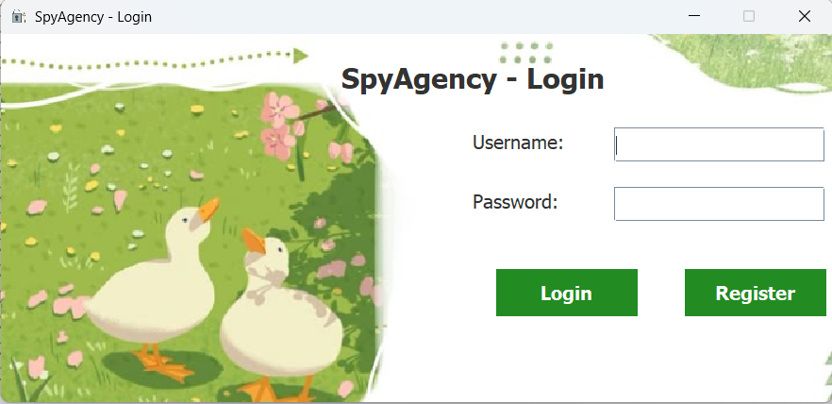
CHAPTER 2
CHAPTER 2
Proposed Solution and Application Design Analysis
2.2. System and User Interface Design Analysis
2.2.2. User Interface Design Analysis
Login Screen:

Slide 39
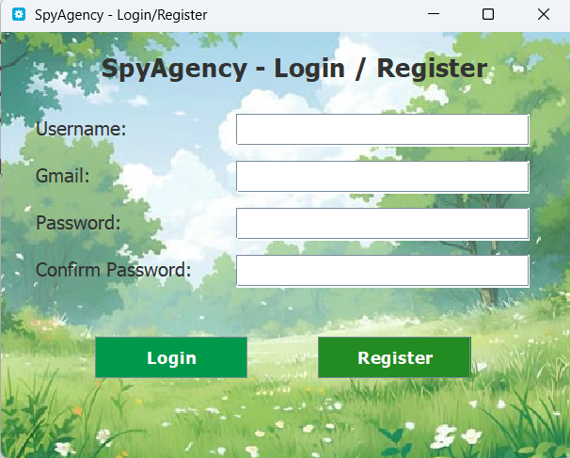
CHAPTER 2
CHAPTER 2
Proposed Solution and Application Design Analysis
2.2. System and User Interface Design Analysis
2.2.2. User Interface Design Analysis
Account Registration Screen:

Slide 40

CHAPTER 2
CHAPTER 2
Proposed Solution and Application Design Analysis
2.2. System and User Interface Design Analysis
2.2.2. User Interface Design Analysis
Dashboard:

Slide 41
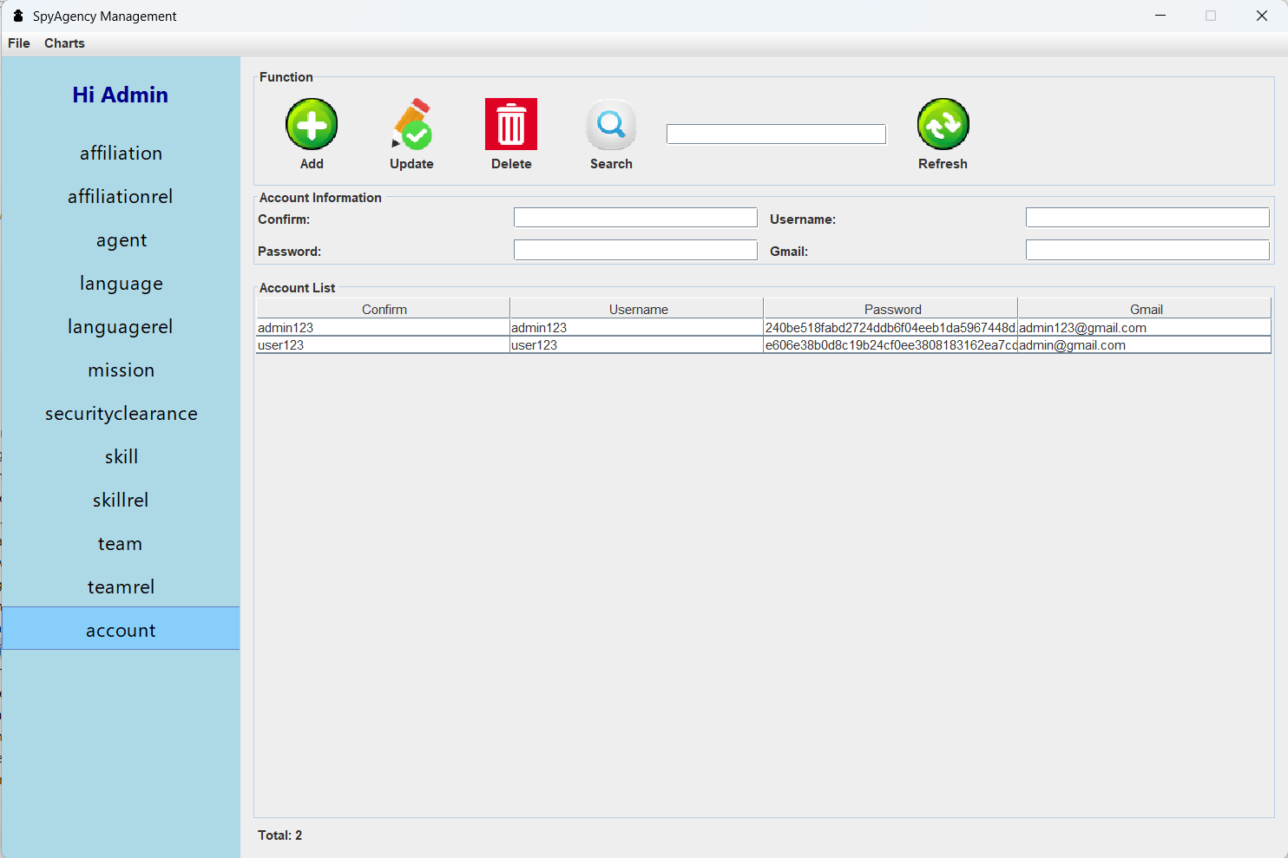
CHAPTER 2
CHAPTER 2
Proposed Solution and Application Design Analysis
2.2. System and User Interface Design Analysis
2.2.2. User Interface Design Analysis
User Management Interface Screen:

Slide 42

CHAPTER 2
CHAPTER 2
Proposed Solution and Application Design Analysis
2.2. System and User Interface Design Analysis
2.2.2. User Interface Design Analysis
Main Chart Interface Screen:

Slide 43
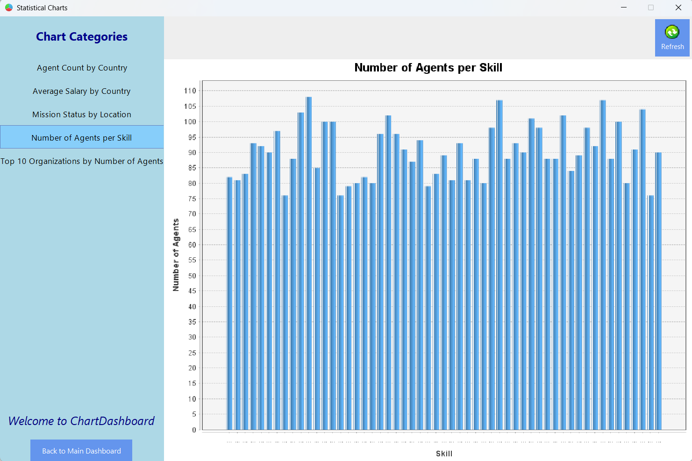
CHAPTER 2
CHAPTER 2
Proposed Solution and Application Design Analysis
2.2. System and User Interface Design Analysis
2.2.2. User Interface Design Analysis
Chart
Viewing
Screen:

Slide 44
CHAPTER 2
CHAPTER 2
Proposed Solution and Application Design Analysis
2.3. User Interface Information
This section describes the process by which a user logs into the Spy Agency Management System and how the system displays the main interface after a successful login
- Launching the application:
+ The login interface is the first screen displayed, controlled by the LoginInterface2.java class.
- User login process:
+ The intelligence officer enters their username and password into the input fields (JTexField and JPasswordField)..
+ They click the "Login" button, which is represented by an icon styled in a modern management software design.
- Login processing:
+ The button click event is handled via an ActionListener
+ The system calls the checkLogin(username, password) method to verify credentials.
The checkLogin method interacts with the AccountDAO class to check the user’s account information stored in the MySQL database.
Passwords are validated after being hashed using the SHA-256 algorithm to ensure security
Login scenarios:
- Successful login:
+ The login window is closed.
+ The application transitions to display the DashboardPanel, which directly controls the main home interface .
+ A welcome message appears in the dashboard: "Hi Admin".
- Failed login:
+ An error message is displayed directly on the interface: "Incorrect username or password.”.

Slide 45
CHAPTER 2
CHAPTER 2
Proposed Solution and Application Design Analysis
2.3. User Interface Information
- Dashboard Interface:
The main interface is divided into two areas:
The left sidebar (Sidebar) contains functional menu items that are customized based on the user's role in the system.
On the right side, a background image is displayed to add color and improve the visual appearance of the interface, creating a more comfortable and user-friendly experience.
Other buttons include:
Logout: Returns the user to the login screen when they want to switch to a different account .
Exit: Closes the application quickly, helping to save time.

Slide 46
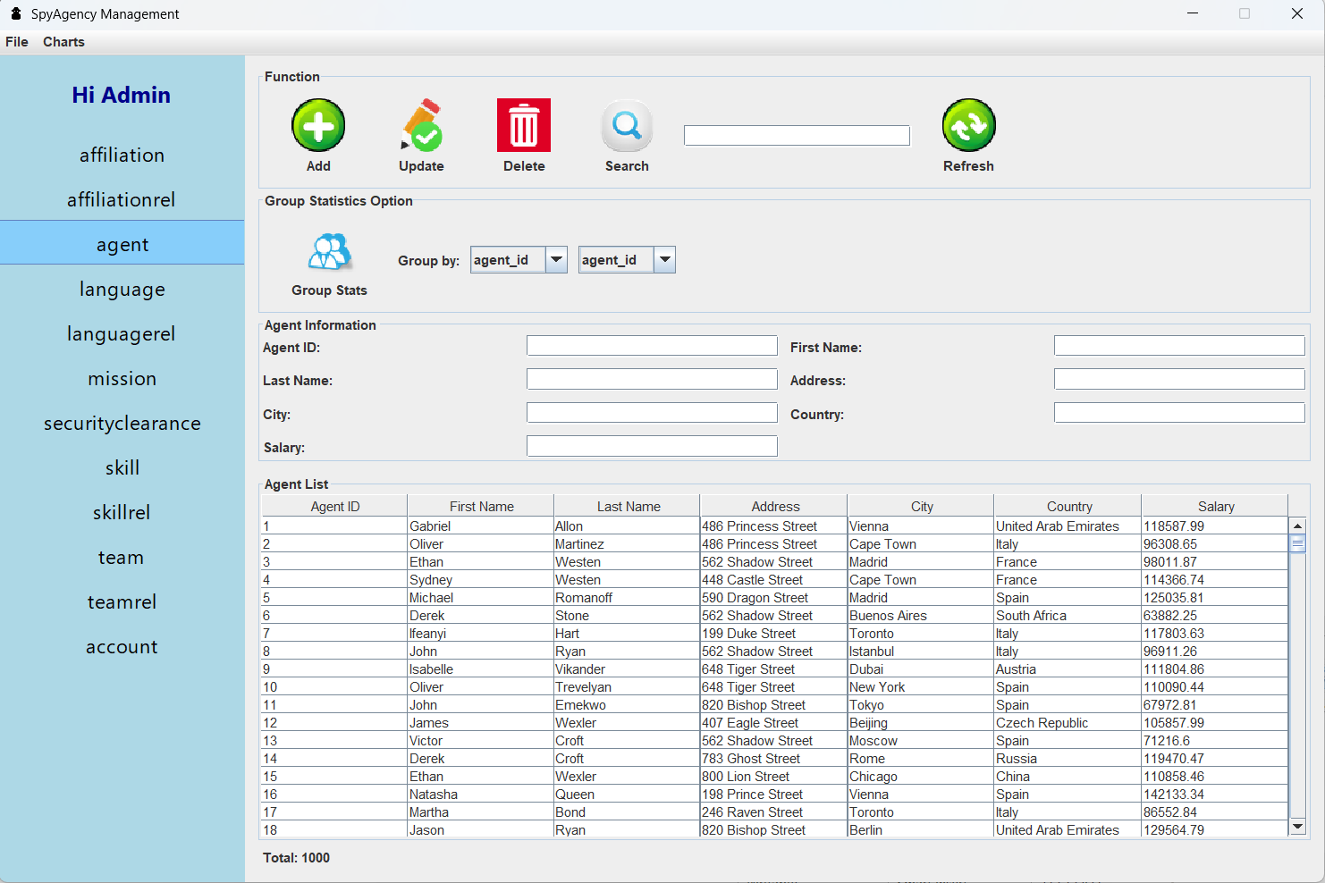
CHAPTER 2
CHAPTER 2
Proposed Solution and Application Design Analysis
2.3. User Interface Information
Other special functions are located in the left sidebar of the main screen. Each button opens a different page, and each page contains full features appropriate for a management application. The functions include: - Add or Create: + The user fills in all required information in the JTextField input fields. + Click the ADD button + The data is automatically saved to the list and also inserted into the database table through the established connection. - Update or Edit: + After selecting a row from the information table below, the user can edit the data as desired. + Click the Update button. + The new information will be updated automatically, and the database will also be updated accordingly. - Delete: + After selecting a row from the information table, the user can choose to delete it + Click the Delete button + A confirmation dialog will appear asking whether the user wants to delete the record. + If confirmed, the selected information will be deleted, and the database will be updated to reflect the removal. - Refresh: + When clicked, all displayed data will be refreshed + Any previously filled input fields will be cleared and reset to blank - Search: + There is a separate input field where users can enter the information they want to search for. + When the Search button is clicked + All relevant information matching the keyword will be displayed. Besides the management pages, there is also a similar management system but with a special feature: the hash information is displayed below for users to view and to modify the data through CRUD functions.

Slide 47
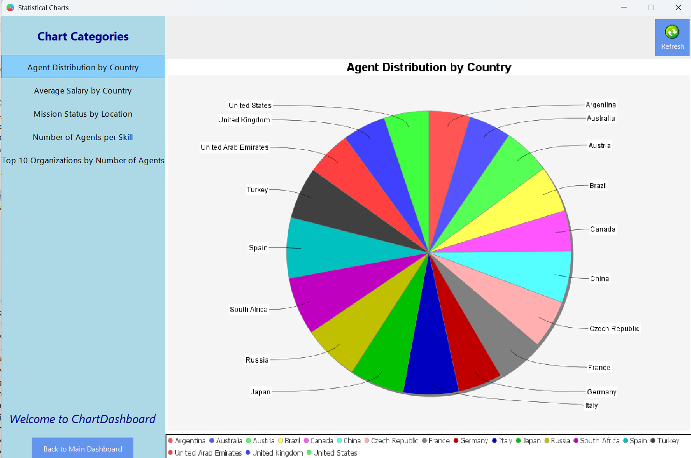
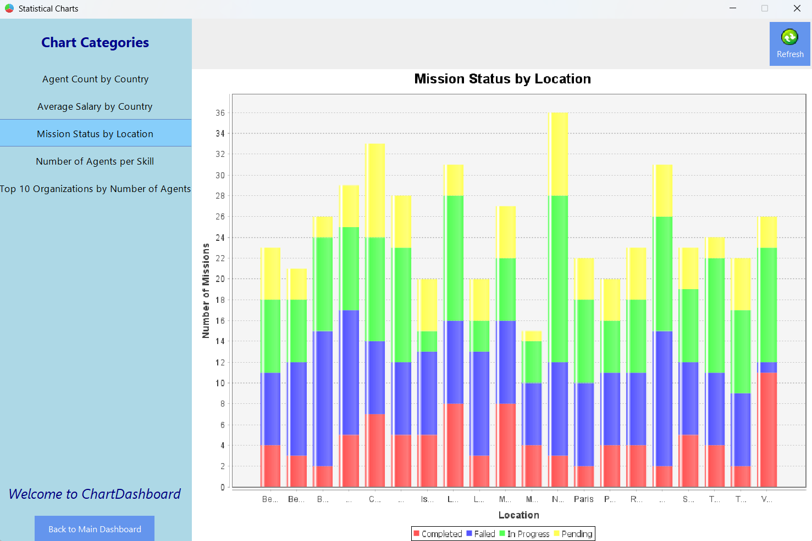
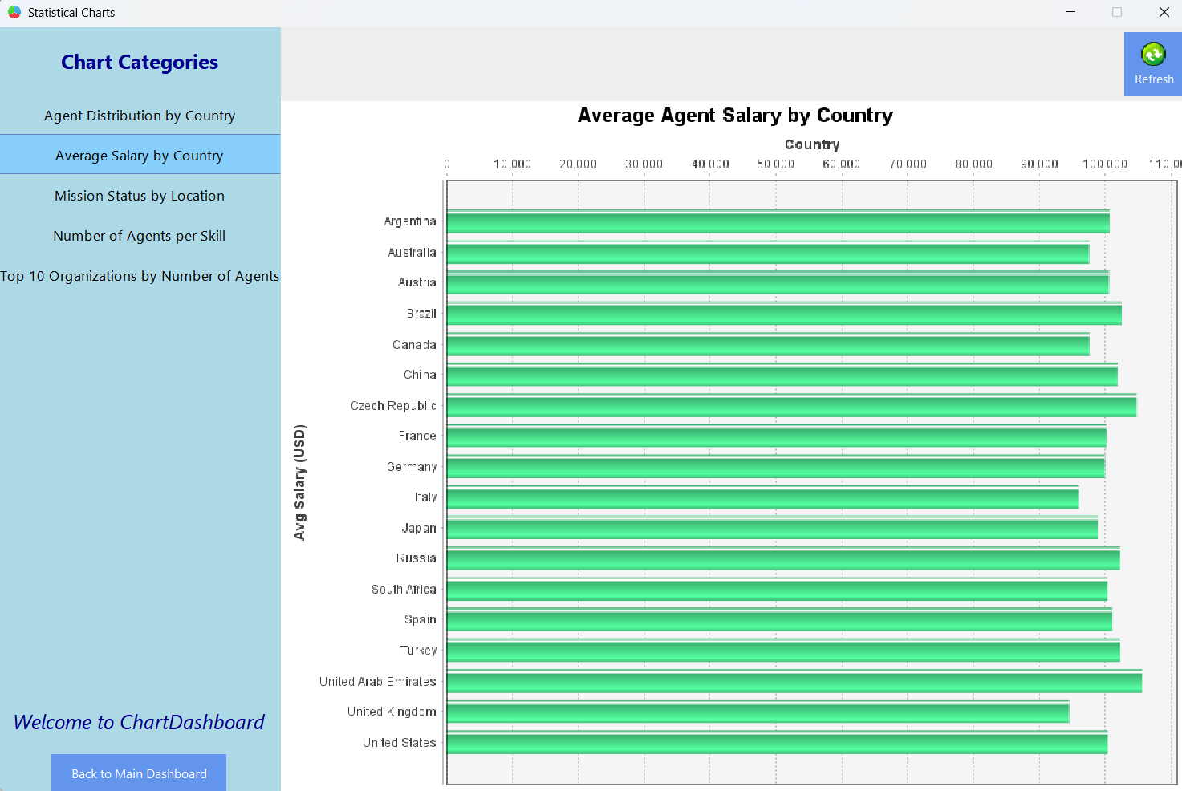
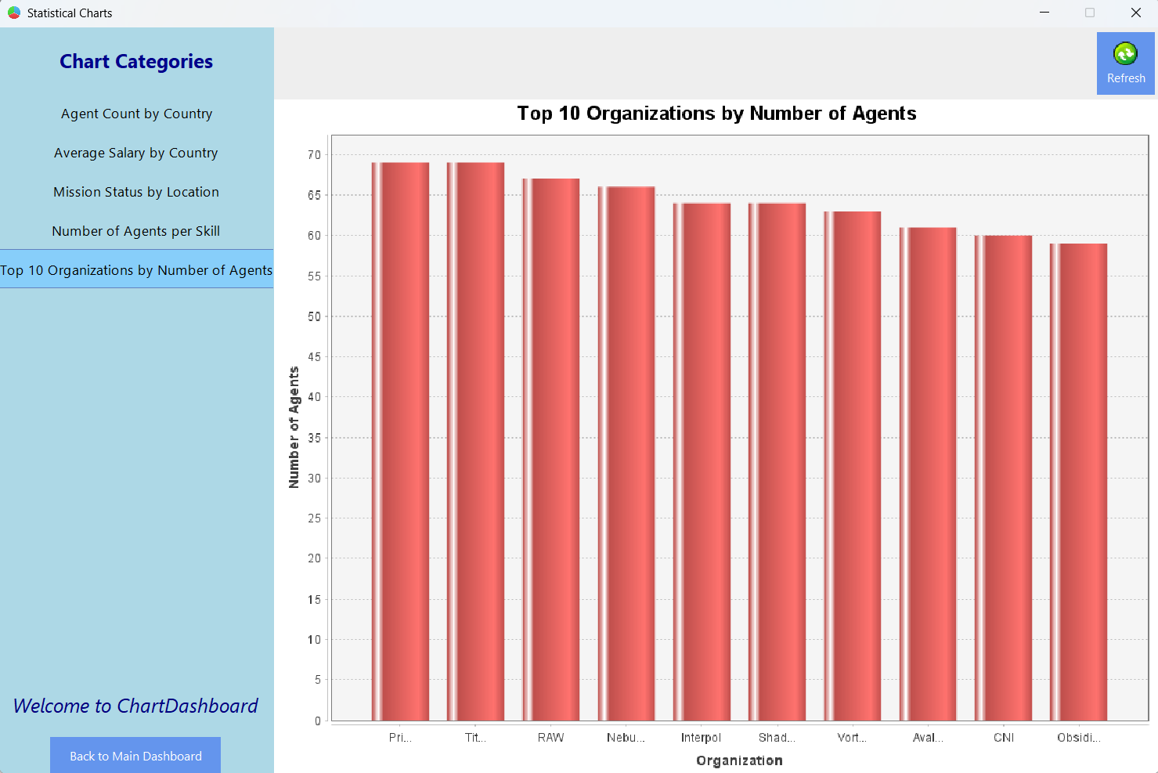
CHAPTER 2
CHAPTER 2
Proposed Solution and Application Design Analysis
2.3. User Interface Information
Statistics and Charts:
Regarding the interface, the ChartDashboard features a visually appealing and user-friendly background, creating a comfortable experience for users. Additionally, the left sidebar contains buttons which, when clicked, display different charts. Although users cannot create their own custom charts, the generated charts are designed to be visually attractive, allowing users to gain a comprehensive overview. All data is connected to MySQL, so any additions, deletions, or updates automatically affect the charts. Next to the charts, there is a refresh button that allows users to update the charts to reflect the most current information. This enables users to quickly grasp the latest data, supporting development and promoting progress in various fields.

Slide 48
CHAPTER 2
CHAPTER 2
Proposed Solution and Application Design Analysis
2.4. MySQL Database Structure
2.4.1. Table Description
1. account – User Account Management Stores login credentials. Fields: id, username, password (hashed), confirm.
2. agent – Agent Information Management Stores agent personal data and salary. Fields: agent_id, first & last name, address, city, country, salary.
3. affiliation – Organization Information Management Stores details of intelligence organizations. Fields: affiliation_id, affiliation name, description.
4. mission – Mission Information Management Stores missions and agent/team/clearance relations. Fields: mission_id, name, location, agent_id, access_id, team_id, status.
5. skill – Spy Skills Category Management Stores types of skills agents can have. Fields: id, skill name.
6. language – Language Category Management Stores languages known by agents. Fields: language_id, language name.\
7. securityclearance – Clearance Level Management Stores levels of security access. Fields: sc_id, level name, description.
8. team – Spy Group Management Stores team info and meeting frequency. Fields: id, team name, meeting frequency.
9. affiliationrel – Agent–Organization Relationship Stores agent affiliation and strength of connection. Fields: agent_id, affiliation_id, affiliation strength.
10. skillrel – Agent–Skill Relationship Stores agent skills. Fields: agent_id, skill_id.
11. languagerel – Agent–Language Relationship Stores agent language abilities. Fields: agent_id, language_id.
12. teamrel – Agent–Team Relationship Stores agent participation in teams. Fields: agent_id, team_id.

Slide 49
CHAPTER 2
CHAPTER 2
Proposed Solution and Application Design Analysis
2.4. MySQL Database Structure
2.4.2. Constraints an Relationships
Constraints:
Primary Key: Each table has an id column as the primary key (PK).
Foreign Key:
agent.security_clearance_id → securityclearance.id
affiliationrel.agent_id → agent.id
affiliationrel.affiliation_id → affiliation.id
skillrel.agent_id → agent.id
skillrel.skill_id → skill.id
languagerel.agent_id → agent.id
languagerel.language_id → language.id
teamrel.agent_id → agent.id
teamrel.team_id → team.id
Unique:
account.username
Not Null:
account.username, account.password, account.role, agent.name, affiliation.name, mission.name, skill.name, language.name, securityclearance.level, team.name

Slide 50
CHAPTER 2
CHAPTER 2
Proposed Solution and Application Design Analysis
2.4. MySQL Database Structure
2.4.2. Constraints an Relationships
Relationships between tables:
account independent.
agent — securityclearance: Relationship 1-n
agent — affiliationrel: Relationship 1-n
agent — skillrel: Relationship 1-n
agent — languagerel: Relationship 1-n
agent — teamrel: Relationship1-n
affiliationrel — affiliation: Relationship n-1
skillrel — skill: Relationship n-1
languagerel — language: Relationship n-1
teamrel — team: Relationship n-1

Slide 51
CHAPTER 3
SYSTEM OPERATION MECHANISM

Slide 52
CHAPTER 3
SYSTEM OPERATION MECHANISM
3.1. Overall Structure
The Spy Agency Management software system is designed and developed based on the Java programming language, combined with a MySQL database for centralized data storage and management. The project is organized following a layered architecture model, closely integrated with the MVC (Model-View-Controller) software design pattern and the DAO (Data Access Object) pattern to separate business logic, user interface, and data processing.
The overall system is divided into separate packages, each responsible for a distinct role or function such as managing models, views, controllers, DAOs, configurations, and charts. This organization ensures the source code is managed scientifically, easy to expand, maintain, and upgrade later
The system structure includes:
- Model: Classes representing data objects.
- DAO: Classes for data operations with MySQL.
- Controller: Handles events and coordinates between View and DAO.
- View: User interface classes built with Java Swing.
- Chart & ChartDAO: Handle data processing and visualization via charts.
- Config: System configuration and database connection
- Icon: Management of icons and UI resources.
This design guarantees that the system can easily develop new features such as statistics, advanced access control, or alerts without affecting the existing structure.

Slide 53
CHAPTER 3
SYSTEM OPERATION MECHANISM
3.2. Model Layer
The Model layer is responsible for representing actual entities within the software system, such as Agent, Mission, Affiliation, Account, Skill, Team, etc. Each main Model class is a Plain Old Java Object (POJO) with private attributes and public getter/setter methods.
Building the Model according to the POJO standard helps to:
- Ensure encapsulation.
- Easily map data to corresponding tables in the database.
- Provide a foundation for flexible data transformation between DAO, Controller, and View layers.
This organization helps maintain consistency of data between the program and the database, facilitating easy addition, update, and deletion of data.

Slide 54
CHAPTER 3
SYSTEM OPERATION MECHANISM
3.3. DAO Layer (Data Access Object)
The DAO layer acts as an intermediary between the system and the database, specializing in data operations such as adding, deleting, updating, and searching. DAO classes like AgentDAO, AffiliationDAO, and MissionDAO use JDBC to execute SQL statements directly and return results to the Controller for further processing.
Advantages:
- Separates SQL queries from the Controller, improving maintainability.
- Easily allows changes to the database or table structure without affecting other layers.
- Reuses methods to avoid code duplication.
DAO also helps handle exceptions and manage connections efficiently, preventing resource leaks.

Slide 55
CHAPTER 3
SYSTEM OPERATION MECHANISM
3.4. Controller Layer
The Controller acts as a coordinator between the View and DAO. It receives user events from the interface, calls DAO methods to perform business operations, and then returns the results to the View for display..
Example:
- When the user clicks the “Add Agent” button, the Controller gathers data from the input form, creates a new Agent object, calls AgentDAO.insertAgent(agent), and then updates the data table display.
Advantages:
- Separates business logic from the UI layer.
- Provides better control over the processing flow and is easier to extend functionality when needed.
Additionally, the Controller performs data validation before sending it to the DAO, ensuring data integrity across the system.

Slide 56
CHAPTER 3
SYSTEM OPERATION MECHANISM
3.5. View Layer (Java Swing)
The View in the system is built using Java Swing, consisting of individual JPanel components like AgentManagementJPanel, MissionManagementJPanel, and AffiliationManagementJPanel. Each View is designed with a modern layout and includes:
+ Labels for titles and descriptions.
+ TextField for user input.
+ ComboBox for quick selection.
+ Button for executing action
+ JTable for displaying data in tabular format.
+ Icon and visual effects for user-friendliness
The UI components are arranged logically, with attractive icons and optimized colors to help users navigate easily and minimize errors during operation.

Slide 57
CHAPTER 3
SYSTEM OPERATION MECHANISM
3.6. Chart and ChartDAO Layers
The system uses the JFreeChart library to visualize data through pie charts, bar charts, and line charts. The Chart class handles chart configuration and rendering, while the ChartDAO class fetches data from MySQL with appropriate queries.
Examples:
- Count the number of agents by nationality using the method AgentChartDAO.countByNationality() and return a dataset for the pie chart.
- Display the number of missions by status (success, failure) in a bar chart..
Advantages:
- Allows managers to monitor data in a visual format.
- Supports trend analysis and efficient organizational performance evaluation.

Slide 58
CHAPTER 3
SYSTEM OPERATION MECHANISM
3.7. Connection Configuration (Config)
The Config class manages database connection parameters such as:
+ Server address.
+ Database name.
+ Username.
+ Password.
+ Port number.
The DBConnection class is designed following the Singleton pattern to ensure only one connection is created and reused across the entire system. This saves resources and prevents errors during simultaneous database access.
Advantages:
+ Easy adjustment of parameters during deployment.
+ Secure connection information management.
+ Avoids repeating connection setup code in each DAO.

Slide 59
CHAPTER 3
SYSTEM OPERATION MECHANISM
3.8. User Authentication Handling
The system includes a user authentication mechanism at the login screen. The authentication process involves:
Entering username and password.
Encrypting the password using the SHA-256 algorithm.
Comparing the encrypted password with the one stored in the Account table.

Slide 60
CHAPTER 4
EXPERIMENTS AND EVALUATION

Slide 61
CHAPTER 4
EXPERIMENTS AND EVALUATION
4.1. Testing Environment and Procedure
To ensure the accuracy and reliability of the system, the testing process was conducted in a specific hardware and software environment, closely aligned with the actual conditions under which modern information management applications operate. The use of an up-to-date testing environment ensures the system meets performance and stability requirements during real-world operation.

Slide 62
CHAPTER 4
EXPERIMENTS AND EVALUATION
4.1. Testing Environment and Procedure
Testing environment configuration:
Operating System: Windows 11 Pro 64-bit
JDK Version: Java Development Kit 17 (LTS)
Database Management System: MySQL Community Server 8.0
Development Tool: IntelliJ IDEA version 2024.1 Ultimate
Chart Library: JFreeChart version 1.5.4
The test data set was constructed with over 1000 records, evenly distributed across the system’s key database tables such as Agent, Mission, Affiliation, Affiliationrel, Skill, Skillrel, Team, Teamrel, Securityclearance, and Account. These records were simulated based on realistic scenarios to ensure diversity and complexity, aiming to test the system’s processing capabilities.

Slide 63
CHAPTER 4
EXPERIMENTS AND EVALUATION
4.1. Testing Environment and Procedure
The testing process was carried out according to standardized steps as follows:
- Login Functionality Testing: Conducted using various user accounts to verify access control, credential validation, and appropriate interface navigation based on user roles.
- Data Management Testing: Performed operations such as adding new records, editing, deleting, and searching across all data tables to ensure data integrity and synchronization between the user interface and the database.
- Statistical Chart Testing: Created charts in various formats such as bar charts, pie charts, and line charts to verify accurate data visualization and support for dynamic updates when data changes.
- Performance Testing: Executed continuous operations with a large dataset to evaluate the application’s responsiveness, concurrent processing capability, and identify any errors or system freezes.

Slide 64
CHAPTER 4
EXPERIMENTS AND EVALUATION
4.1. Testing Environment and Procedure
The testing was carried out across multiple sessions using simulated error scenarios such as incorrect login attempts, duplicate primary keys, and deletion of records being referenced—this was done to evaluate the system’s exception handling and stability

Slide 65
CHAPTER 4
EXPERIMENTS AND EVALUATION
4.2. Testing Results
After conducting comprehensive testing based on the established plan, the results are as follows:
- Login Functionality: The system successfully validates login credentials. Cases such as non-existent accounts, incorrect passwords, or unauthorized access are correctly handled. Upon successful login, the system displays the interface corresponding to the user's role, clearly distinguishing between administrative and regular user features.
- Data Management: All CRUD functions for each table performed correctly as specified. The user interface updates in real-time, ensuring data displayed matches the actual database records. The system supports fast keyword searches and filtering based on specific criteria, offering convenience and time efficiency.
- Chart Visualization: The system generates accurate and visually intuitive charts across multiple types. Charts dynamically update upon data changes without requiring a program restart. Rendering speed is fast, with clear colors, labels, and complete information, enhancing monitoring and analytical capabilities.
- Performance: During tests involving over 1000 records and prolonged usage, the system remained stable with no runtime errors or application freezes. CRUD operations responded within an average of 1 second, indicating satisfactory real-world performance.
Additionally, the system was tested with simulated exceptions such as inserting duplicate primary keys, deleting records referenced by foreign keys, and repeated incorrect login attempts. All exceptions were handled correctly, and informative messages were displayed to users.

Slide 66
CHAPTER 4
EXPERIMENTS AND EVALUATION
4.3. Product Evaluation
After a comprehensive testing process, the system has demonstrated strong capability in meeting the initial functional requirements. The product can be evaluated based on the following criteria:

Slide 67
CHAPTER 4
EXPERIMENTS AND EVALUATION
4.3. Product Evaluation
Strengths:
Adoption of a Standardized MVC Architecture:
- The system is built upon the Model-View-Controller (MVC) architecture, which clearly separates concerns among data models, business logic, and user interfaces. This structure enhances maintainability and scalability while making future development more manageable and controlled.
Modern and User-Friendly Interface: - The user interface is designed with a modern aesthetic, using harmonious colors and logically arranged features. This ensures users can quickly become familiar with the system and perform management tasks efficiently..
Intuitive Chart Integration for Data Analysis: - By integrating data visualization charts, the system serves not only as a data management tool but also as a platform for analytical insights, supporting better decision-making and reporting.
Stable Performance with Large Data Volumes: - The system handles more than 1,000 records smoothly, maintaining fast response times and error-free operation even under multiple concurrent actions.

Slide 68
CHAPTER 4
EXPERIMENTS AND EVALUATION
4.3. Product Evaluation
Limitations:
Lack of Multi-Language Support: - Currently, the interface supports only English. This limitation may affect usage in international or multilingual organizations. Future versions should include language selection or bilingual support to expand the system’s usability.
Absence of Advanced Analytical Features: - The current system offers basic statistical and charting features. Advanced capabilities such as agent activity prediction, relationship analysis between agents and missions, or team performance evaluation have not yet been implemented. These features represent potential areas for future development to increase the product’s value.
Conclusion: Through thorough testing and evaluation, the system has proven to meet expectations in terms of functionality, performance, and user interface. It provides a solid foundation for further feature expansion, enhanced analytics, and integration with other systems in future iterations..

Slide 69


CONCLUSION

Slide 70
C
O
N
C
L
U
S
I
O
N
After a serious process of research, design, and development, the project “SpyAgency2024 – Agent Data Management and Analysis System” has successfully achieved the initial goals. A desktop application was developed to manage agent information, missions, and related entities, with robust data visualization features, a user-friendly interface, and strong security. The key outcomes of the project include:
1. Successfully implemented User Management and Authentication
The application provides full login and logout features, along with secure session management. User passwords are encrypted using the SHA-256 algorithm before being stored in the MySQL database to ensure security. Additionally, users can update their personal information, and an administrator interface is available for managing user accounts, assigning permissions, editing information, and deactivating accounts when necessary. This ensures secure and appropriate access control..
2. Developed a comprehensive module for managing agents and related data entities
The system features a user-friendly and well-structured interface that supports full CRUD (Create, Read, Update, Delete) operations on key data tables such as Agent, Mission, Affiliation, Skill, Language, Team, and relationship tables including AffiliationRel, LanguageRel, SkillRel, and TeamRel. The MySQL database is designed with a normalized structure, ensuring data integrity and high scalability.
Integration with MySQL tools allows for efficient data inspection and management. Sample data were created based on realistic intelligence agency scenarios, including comprehensive details on agents, missions, organizations, and access permissions, making the data handling process more intuitive.
3. Implemented data visualization features using charts
The project successfully integrates the JFreeChart library to visualize agent and mission data in dynamic charts. The implemented chart types include:
Bar Chart: Visualizes agent distribution by nationality or by team.
Pie Chart: Displays the proportion of agents by security clearance level.
Line Chart: Shows the trend of mission completion over months or years..
Users can select parameters such as country, team, or time period to customize the visualizations for specific analytical needs, thereby enhancing the effectiveness of agent management and monitoring.

Slide 71
After a serious process of research, design, and development, the project “SpyAgency2024 – Agent Data Management and Analysis System” has successfully achieved the initial goals. A desktop application was developed to manage agent information, missions, and related entities, with robust data visualization features, a user-friendly interface, and strong security. The key outcomes of the project include:
1. Successfully implemented User Management and Authentication
The application provides full login and logout features, along with secure session management. User passwords are encrypted using the SHA-256 algorithm before being stored in the MySQL database to ensure security. Additionally, users can update their personal information, and an administrator interface is available for managing user accounts, assigning permissions, editing information, and deactivating accounts when necessary. This ensures secure and appropriate access control..
C
O
N
C
L
U
S
I
O
N
2. Developed a comprehensive module for managing agents and related data entities
The system features a user-friendly and well-structured interface that supports full CRUD (Create, Read, Update, Delete) operations on key data tables such as Agent, Mission, Affiliation, Skill, Language, Team, and relationship tables including AffiliationRel, LanguageRel, SkillRel, and TeamRel. The MySQL database is designed with a normalized structure, ensuring data integrity and high scalability.
Integration with MySQL tools allows for efficient data inspection and management. Sample data were created based on realistic intelligence agency scenarios, including comprehensive details on agents, missions, organizations, and access permissions, making the data handling process more intuitive.
3. Implemented data visualization features using charts
The project successfully integrates the JFreeChart library to visualize agent and mission data in dynamic charts. The implemented chart types include:
Bar Chart: Visualizes agent distribution by nationality or by team.
Pie Chart: Displays the proportion of agents by security clearance level.
Line Chart: Shows the trend of mission completion over months or years..
Users can select parameters such as country, team, or time period to customize the visualizations for specific analytical needs, thereby enhancing the effectiveness of agent management and monitoring.
4. Effectively applied Object-Oriented Programming (OOP) techniques and Java technologies
During the design and development process, the project made full use of OOP principles such as encapsulation, inheritance, and polymorphism in designing the POJO classes (Agent, Mission, Affiliation, Team, Skill, Language), DAO classes (AgentDAO, MissionDAO, AffiliationDAO, etc.), and service classes that handle business logic (AuthService, ChartService, MissionService).
The project also applied modern technologies and tools:
Java Swing: Used for building the intuitive desktop graphical user interface (GUI)..
5. Completed a well-structured project and documentation system
All source code, resources (icons, images, CSS), FXML configuration files, and SQL scripts (for table creation and sample data insertion) are organized clearly and professionally following real-world project standards. In addition, the project includes comprehensive technical documentation, a user manual, and a design analysis report, supporting future deployment, operation, and expansion.

Slide 72
2. Developed a comprehensive module for managing agents and related data entities
The system features a user-friendly and well-structured interface that supports full CRUD (Create, Read, Update, Delete) operations on key data tables such as Agent, Mission, Affiliation, Skill, Language, Team, and relationship tables including AffiliationRel, LanguageRel, SkillRel, and TeamRel. The MySQL database is designed with a normalized structure, ensuring data integrity and high scalability.
Integration with MySQL tools allows for efficient data inspection and management. Sample data were created based on realistic intelligence agency scenarios, including comprehensive details on agents, missions, organizations, and access permissions, making the data handling process more intuitive.
3. Implemented data visualization features using charts
The project successfully integrates the JFreeChart library to visualize agent and mission data in dynamic charts. The implemented chart types include:
Bar Chart: Visualizes agent distribution by nationality or by team.
Pie Chart: Displays the proportion of agents by security clearance level.
Line Chart: Shows the trend of mission completion over months or years..
Users can select parameters such as country, team, or time period to customize the visualizations for specific analytical needs, thereby enhancing the effectiveness of agent management and monitoring.
C
O
N
C
L
U
S
I
O
N
4. Effectively applied Object-Oriented Programming (OOP) techniques and Java technologies
During the design and development process, the project made full use of OOP principles such as encapsulation, inheritance, and polymorphism in designing the POJO classes (Agent, Mission, Affiliation, Team, Skill, Language), DAO classes (AgentDAO, MissionDAO, AffiliationDAO, etc.), and service classes that handle business logic (AuthService, ChartService, MissionService).
The project also applied modern technologies and tools:
Java Swing: Used for building the intuitive desktop graphical user interface (GUI)..
5. Completed a well-structured project and documentation system
All source code, resources (icons, images, CSS), FXML configuration files, and SQL scripts (for table creation and sample data insertion) are organized clearly and professionally following real-world project standards. In addition, the project includes comprehensive technical documentation, a user manual, and a design analysis report, supporting future deployment, operation, and expansion.
Future Development Directions
Although the SpyAgency2024 application has achieved many positive results, there are several promising directions for future development:
Add notification and security alert features to monitor suspicious account activities..
Develop AI-based analytics to assess risk levels in mission assignments.
Design a real-time dashboard to provide a comprehensive overview of agents, missions, and organizational data.
Integrate multi-language support to serve international users.
With the results achieved, it can be affirmed that the SpyAgency2024 project not only helped the developer consolidate and apply knowledge of Java programming, databases, and data visualization but also resulted in a practical, high-utility software product. This provides a solid foundation for further research and development of advanced features in the field of intelligence data management and analysis, supporting supervision, administration, and information processing in security organizations

Slide 73
4. Effectively applied Object-Oriented Programming (OOP) techniques and Java technologies
During the design and development process, the project made full use of OOP principles such as encapsulation, inheritance, and polymorphism in designing the POJO classes (Agent, Mission, Affiliation, Team, Skill, Language), DAO classes (AgentDAO, MissionDAO, AffiliationDAO, etc.), and service classes that handle business logic (AuthService, ChartService, MissionService).
The project also applied modern technologies and tools:
Java Swing: Used for building the intuitive desktop graphical user interface (GUI)..
5. Completed a well-structured project and documentation system
All source code, resources (icons, images, CSS), FXML configuration files, and SQL scripts (for table creation and sample data insertion) are organized clearly and professionally following real-world project standards. In addition, the project includes comprehensive technical documentation, a user manual, and a design analysis report, supporting future deployment, operation, and expansion.
C
O
N
C
L
U
S
I
O
N
Future Development Directions
Although the SpyAgency2024 application has achieved many positive results, there are several promising directions for future development:
Add notification and security alert features to monitor suspicious account activities..
Develop AI-based analytics to assess risk levels in mission assignments.
Design a real-time dashboard to provide a comprehensive overview of agents, missions, and organizational data.
Integrate multi-language support to serve international users.
With the results achieved, it can be affirmed that the SpyAgency2024 project not only helped the developer consolidate and apply knowledge of Java programming, databases, and data visualization but also resulted in a practical, high-utility software product. This provides a solid foundation for further research and development of advanced features in the field of intelligence data management and analysis, supporting supervision, administration, and information processing in security organizations

Slide 74

THANKS FOR WATCHING!

